Slide 1

Clustering on Global Development Measurements
Clustering techniques are powerful tools that can be used to group similar objects together. When applied to global development data, these techniques can reveal hidden patterns and insights.

Slide 2

Shared Vision and Goals
Team members:
Vikraj Shambhu
Shaikh Banisha Begum
Shashank Patil
Unnati kalmase
Pranjal Shobhnath Yadav
Sanchit Dattatray Dakle

Slide 3
Objective and Introduction to Global Development Measurements
Business Objective: Creating clusters on global development measurement dataset.
Aim: The objective of the analysis is to form clusters based on the given global development measurement data.
Comprehensive Data
Uncovering Patterns
Informing Policy
Global development data covers a wide range of economic, social, and environmental indicators for countries worldwide.
Analyzing this data can reveal underlying relationships and groupings among countries based on their development profiles.
Insights from clustering can guide policymakers in designing more effective strategies to address development challenges.

Slide 4
Clustering on Global Development Measurements: Plan
1
1. Dataset details and Pre-processing
2
2. Exploratory Data Analysis
Gather data from reputable sources and clean/transform it for analysis.
Examine the data for insights and patterns.
3
3. Feature Selection and Dimensionality Reduction
4
4. Clustering Algorithms
Select relevant features and reduce the dimensionality of the data.
Apply various clustering techniques, such as k-means, hierarchical clustering, DBSCAN.
5
5. Evaluating Cluster Quality
6
6. Interpreting Cluster Characteristics
Assess the performance of different clustering methods using appropriate metrics.
Analyze the characteristics of each cluster and draw meaningful conclusions.
7
7. Deployment: Applying Clustering to Data
8
8. Conclusions and Future Directions
Deploying the application of clustering to a real-world dataset.
Summarize findings and identify potential areas for further research.

Slide 5
Dataset Description
Number of Rows (Entries): 2704
Number of Columns: 25
Data Types:
Float64: 17
Int64: 2
Object: 6
Time Span: Covers data over 13 years
Missing Data:
The data table has missing values in several columns. This could be due to data unavailability or reporting inconsistencies.
While most features are numerical, some values contain special characters like ‘$’,’%’ and’,’, which can be interpreted as objects or strings by machine learning algorithms. This requires careful data pre-processing to ensure that the data is properly understood and utilized.

Slide 6
Column-wise Analysis
Column Name
Non-Null Count
Data Type
Description (Inferred)
Birth Rate
2585
float64
Birth rate per 1000 population
Business Tax Rate
1423
object
Business tax rate (likely a percentage)
CO2 Emissions
2125
float64
CO2 emissions per capita (likely in metric tons)
Country
2704
object
Country name
Days to Start Business
1718
float64
Number of days to start a business
Ease of Business
185
float64
Ease of doing business index (likely a scale)
Energy Usage
1785
float64
Energy consumption per capita (likely in kilowatt-hours)
GDP
2494
object
Gross Domestic Product (likely in currency)
Health Exp % GDP
2395
float64
Healthcare expenditure as a percentage of GDP
Health Exp/Capita
2395
object
Healthcare expenditure per capita (likely in currency)
Hours to do Tax
1416
float64
Number of hours to pay taxes
Infant Mortality Rate
2444
float64
Infant mortality rate per 1000 live births
Internet Usage
2531
float64
Internet usage percentage
Lending Interest
1880
float64
Lending interest rate
Life Expectancy Female
2568
float64
Life expectancy for females (in years)
Life Expectancy Male
2568
float64
Life expectancy for males (in years)
Mobile Phone Usage
2537
float64
Mobile phone usage percentage
Number of Records
2704
int64
Number of records (likely for data source)
Population 0-14
2484
float64
Population percentage aged 0-14
Population 15-64
2484
float64
Population percentage aged 15-64
Population 65+
2484
float64
Population percentage aged 65+
Population Total
2704
int64
Total population
Population Urban
2678
float64
Percentage of urban population
Tourism Inbound
2336
object
Tourism inbound (likely in number of tourists or revenue)
Tourism Outbound
2233
object
Tourism outbound (likely in number of tourists or revenue)

Slide 7
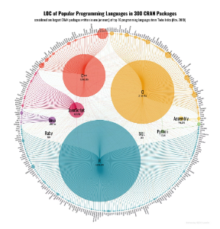
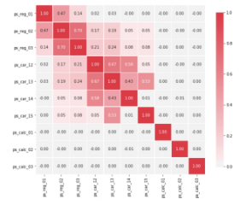


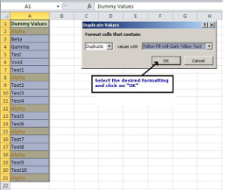
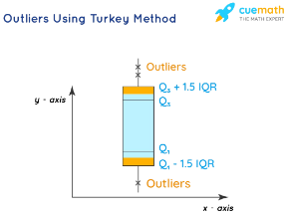
Exploratory Data Analysis
Removing symbols, converting to float
Dropping unnecessary columns
Describing data
Correlation analysis
Creating visualizations
1
2
3
4
5
6
7
8
9
Renaming columns
Dealing with missing values
Addressing outliers
Handling duplicate values

Slide 8
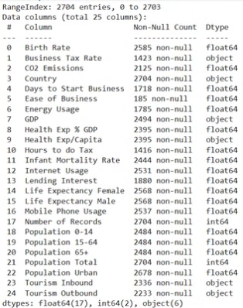
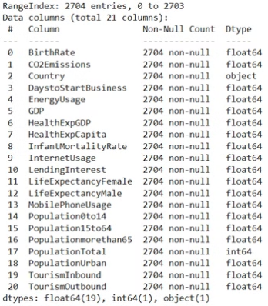
Dealing with Missing Values
Our analysis revealed a significant number of NULL values across all features in the dataset. To address this, we first removed unnecessary columns and renamed others for our specific use case.
We then employed the KNN Imputer module to handle the remaining NULL values. Before applying the KNN Imputer, we normalized the data to ensure consistency and optimal performance. The KNN Imputer utilizes the K-Nearest Neighbor Algorithm to estimate missing values based on their closest neighbours in the dataset.
After completing the imputation process, we observed 208 unique country names, each appearing 13 times in the dataset.
BEFORE AFTER

Slide 9
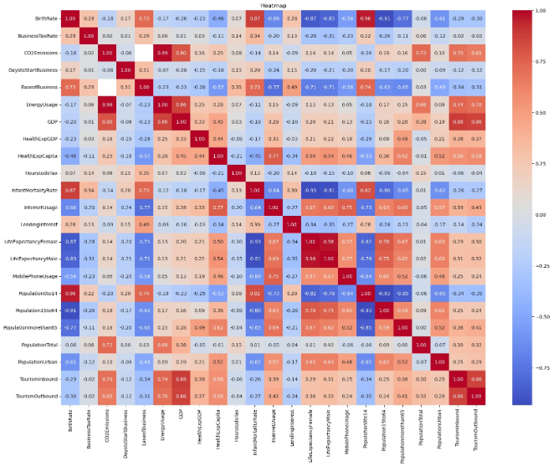
Correlation Matrix Insights
The correlation matrix reveals complex interdependencies between demographic, economic, demographic, and health indicators. Key findings include:
Positive Correlations:
Ease of business with birth rate (0.73)
Ease of business with infant mortality (0.87)
CO2 emissions and energy usage (0.99)
Negative Correlations:
Infant mortality with life expectancy for Females (-0.93) and Males (-0.91)
Health expenditure with life expectancy for Females (-0.87) and Males (-0.83)
Internet usage with infant mortality (-0.64)
These findings suggest that economic development and improved health infrastructure can positively impact various social and economic indicators.

Slide 10
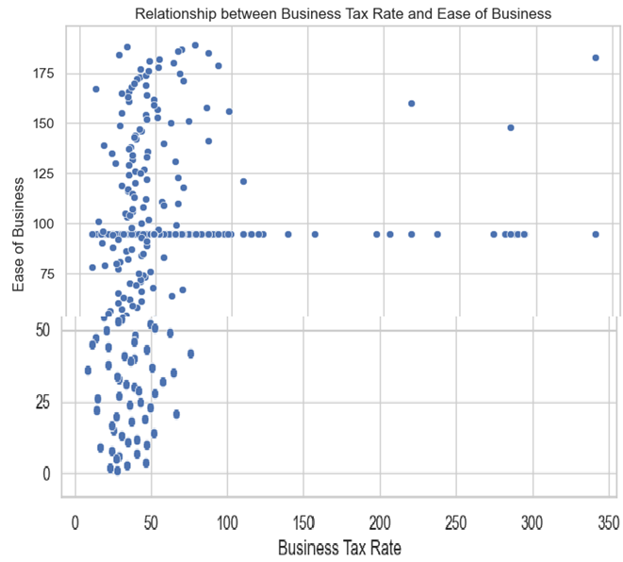
Data Visualization.
Relation between Business Tax Rate & Ease of Business:
The scatter plot shows a general negative relationship between business tax rate and ease of business. This means that as the business tax rate increases, the ease of business tends to decrease.

Slide 11
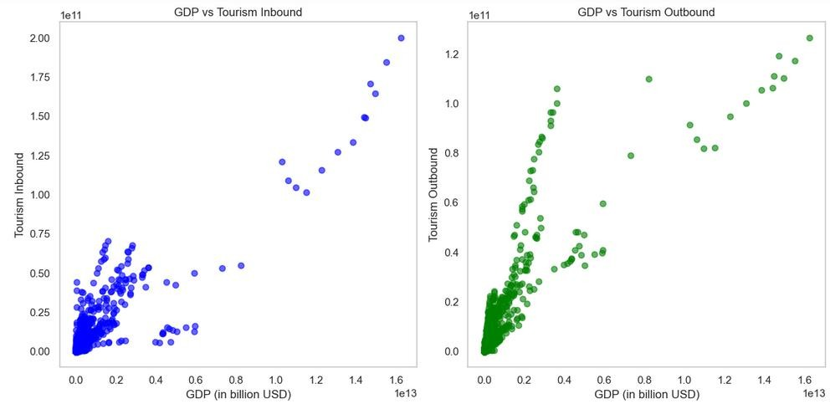
Data Visualization
Relation between GDP & Total population:
This shows as GDP increases Tourism inbound and outbound increases

Slide 12
Feature Selection and Dimensionality Reduction
Identifying Relevant Features
Determine which development indicators are most informative for the clustering analysis.
Reducing Complexity
Apply dimensionality reduction technique Principal Component Analysis (PCA) to create a more manageable set of features while preserving key information.
How PCA works:
Standardization: Data is standardized to have zero mean and unit variance.
Covariance Matrix: The covariance matrix is calculated to understand the relationships between variables.
Eigenvalue Decomposition: The covariance matrix is decomposed into eigenvalues and eigenvectors.
Principal Components: Eigenvectors with the highest eigenvalues are selected as principal components, representing directions of maximum variance.
Dimensionality Reduction: Data is projected onto the selected principal components, reducing dimensionality.
Enhancing Performance
Optimized feature selection and dimensionality reduction can improve the efficiency and accuracy of the clustering algorithms.

Slide 13
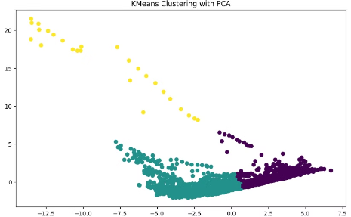
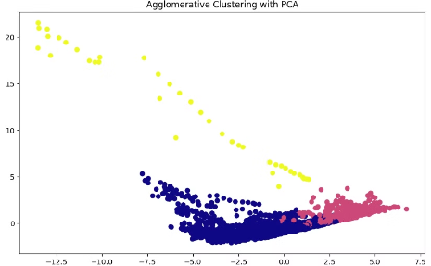
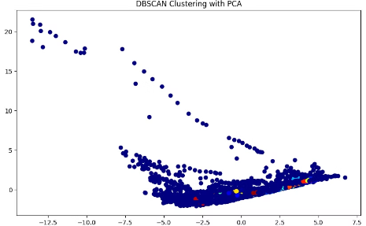
Clustering Algorithms
Clustering algorithms are a type of unsupervised learning technique used to group similar data points together. They identify patterns and structures within data without explicit labels or categories.
K-Means Clustering
Hierarchical Clustering
DBSCAN
A widely-used algorithm that partitions the data into K clusters based on similarities in the feature space.
Builds a hierarchy of clusters, allowing for the exploration of different levels of granularity in the data.
A density-based clustering algorithm that can identify clusters of arbitrary shape and size, and handle outliers.

Slide 14
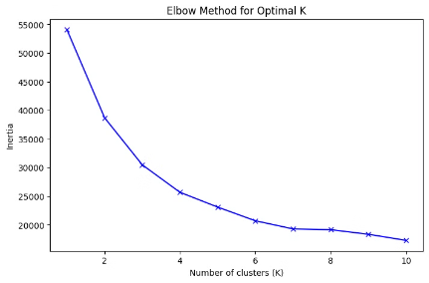
Evaluating Cluster Quality
Elbow Method
Identifies the optimal number of clusters by examining the within-cluster sum of squares as a function of the number of clusters.
Silhouette Score
Measures how well each data point fits within its assigned cluster, providing an overall assessment of cluster cohesion.
Cluster Visualization
Plotting the data in a 2D or 3D space can help visualize and interpret the cluster structures.

Slide 15




Interpreting Cluster Characteristics
Cluster Profiles
Cluster Labeling
Cluster Interpretation
Analyze the development indicator values for each cluster to understand the unique characteristics and similarities of the countries within.
Assign meaningful labels to clusters based on their development profiles, this helps in understanding the characteristics of each cluster.
Interpret the clusters in the context of global development patterns, identifying potential drivers and implications for policy decisions.

Slide 16
Model Deployment
This Streamlit application allows users to analyze and cluster countries based on global development indicators using K-Means clustering.
Key functionalities:
Data Loading: Loads data from an Excel file containing development indicators.
Data Preprocessing:
Selects numerical columns for clustering.
Handles missing values using median imputation.
Standardizes data using StandardScaler.
Clustering Parameters:
Users can select the number of clusters (2-10) through a sidebar slider.
K-Means Clustering:
Performs K-Means clustering with the selected number of clusters.
Assigns cluster labels to each data point.
Results:
Displays the clustered data with assigned labels.
Provides a scatter plot visualization of clusters based on user-selected features.
Shows the centers of each cluster after inverse transformation for interpretability.

Slide 17
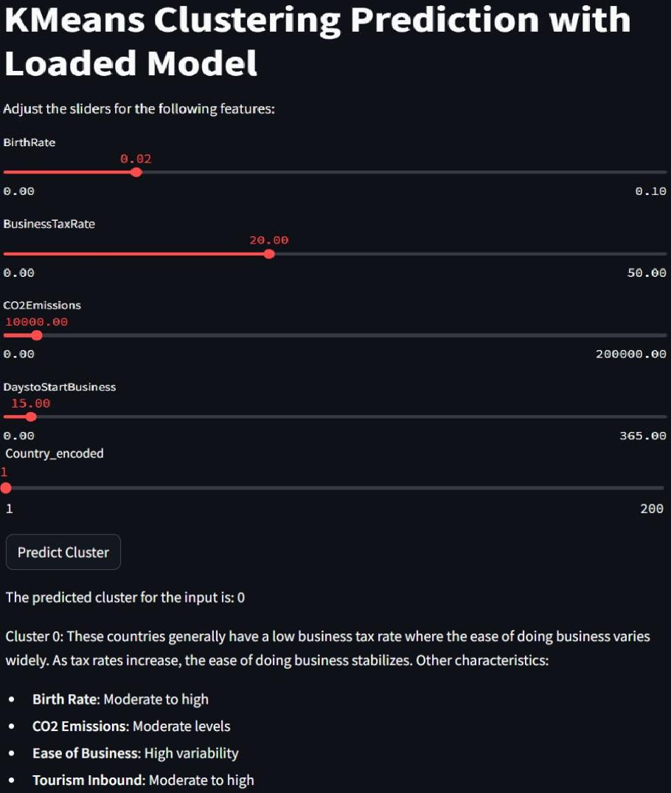

Slide 18
Challenges Faced
1 : Selecting an appropriate number of clusters is crucial to obtaining meaningful insights. Too few clusters may oversimplify the data, while too many can result in overfitting or capturing noise.
2 : Different features have vastly different scales (e.g., Birth Rate vs. GDP). KMeans clustering is sensitive to feature scales, which can lead to biased clustering.

Slide 19




Conclusions and Future Directions
Expanding Scope
Explore the potential to apply clustering techniques to a wider range of development data, including environmental and social indicators.
Interdisciplinary Approaches
Foster collaboration with experts in fields like economics, political science, and sustainable development to enhance the interpretability and impact of the clustering insights.
Advancing Methodologies
Investigate new clustering algorithms and techniques that can better capture the complex, multidimensional nature of global development.

Slide 20

Thank You
We believe this research holds significant potential for informing global development strategies.

